Slide 1
Deep Learning: limitations and roadblocks
Alberto TONDA, Ph.D. (Senior permanent researcher, DR)
UMR 518 MIA-PS, INRAE, AgroParisTech, Université Paris-Saclay UAR 3611, Institut des Systèmes Complexes de Paris Île-de-France

Slide 2
This is a new thing
Ciao
Ciaooooooooooooooo

Slide 3
Deep learning achieved incredible results
Since 2012, impressive advancements in image analysis
Human-competitive gameplay on difficult games
Winning against the Go world champion (2016)
Atari challenge approached with Deep Reinforcement Learning
Generative models
Images (Stable Diffusion), videos (Sora from OpenAI)
Text that captures semantics (GPT-4)
Text-to-speech, speech-to-text (elevenlabs.io, now OpenAI)
Prediction of protein folding (AlphaFold 2.0)
Minor revolution in molecular biology

Slide 4
Deep Learning solved Artificial Intelligence?
Artifical intuition
Critics of DL point out that this is not reasoning

Slide 5
Main roadblocks ahead
Gary Marcus, The next decade in AI, 2020
Black-box nature of the models
Strong hints of overfitting or lack of extrapolation
AlphaGo loses against nonsensical strategies
Deep RL for video games loses if starting point is 1-pixel away
Gaming algorithms
Models are fragile
Can fail in multiple (infinite?) ways
Unpredictable failures

Slide 6
The road ahead
The DL research community is split
Keep going with DL
Larger and larger models
New types of layers
New approaches
Hybridize DL with symbolic reasoning (neural-symbolic AI, NeSy)
Radically new approaches that learn (more) human-like

Slide 7
Issues with Machine Learning
Some of the problems are not DL-specific, but due to ML
ML does not find causal links, just mines correlations
If you do not keep this in mind, you are going to have a bad time
Add here some excellent failures
Problems in the data
Black-box effect
Problems in your assumptions

Slide 8
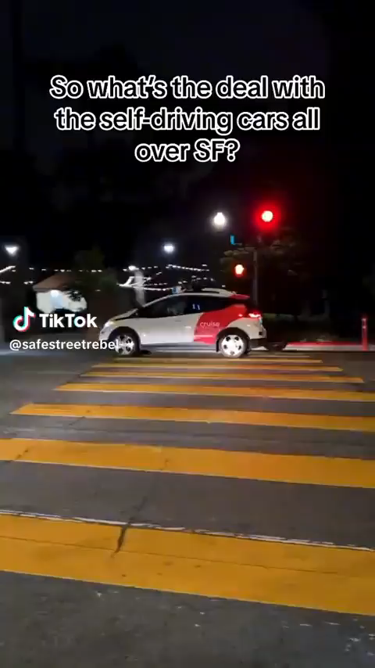
Black-box + correlations = mistakes

Slide 9
Black box + correlations = mistakes
Radiology

